Slide 1
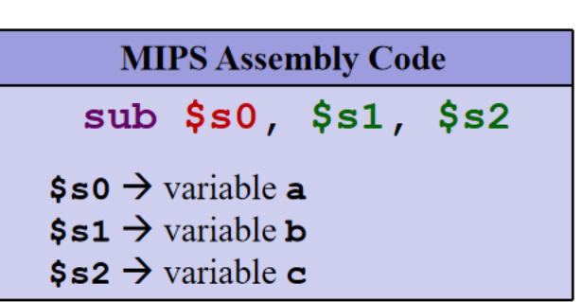
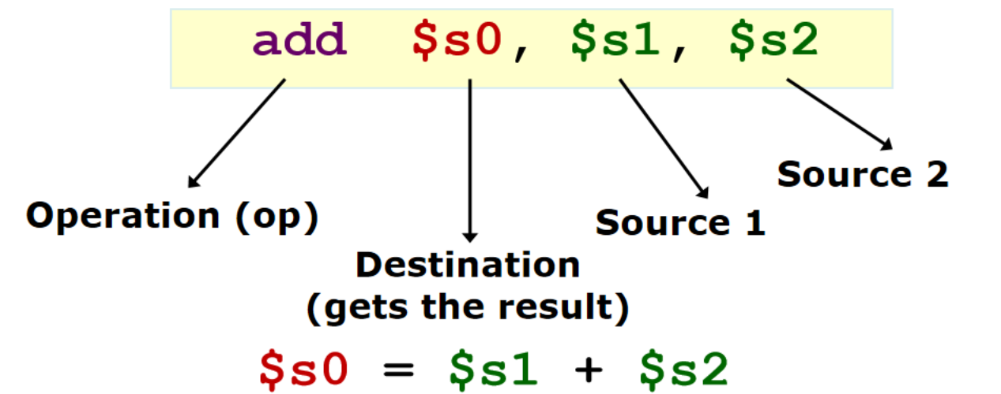
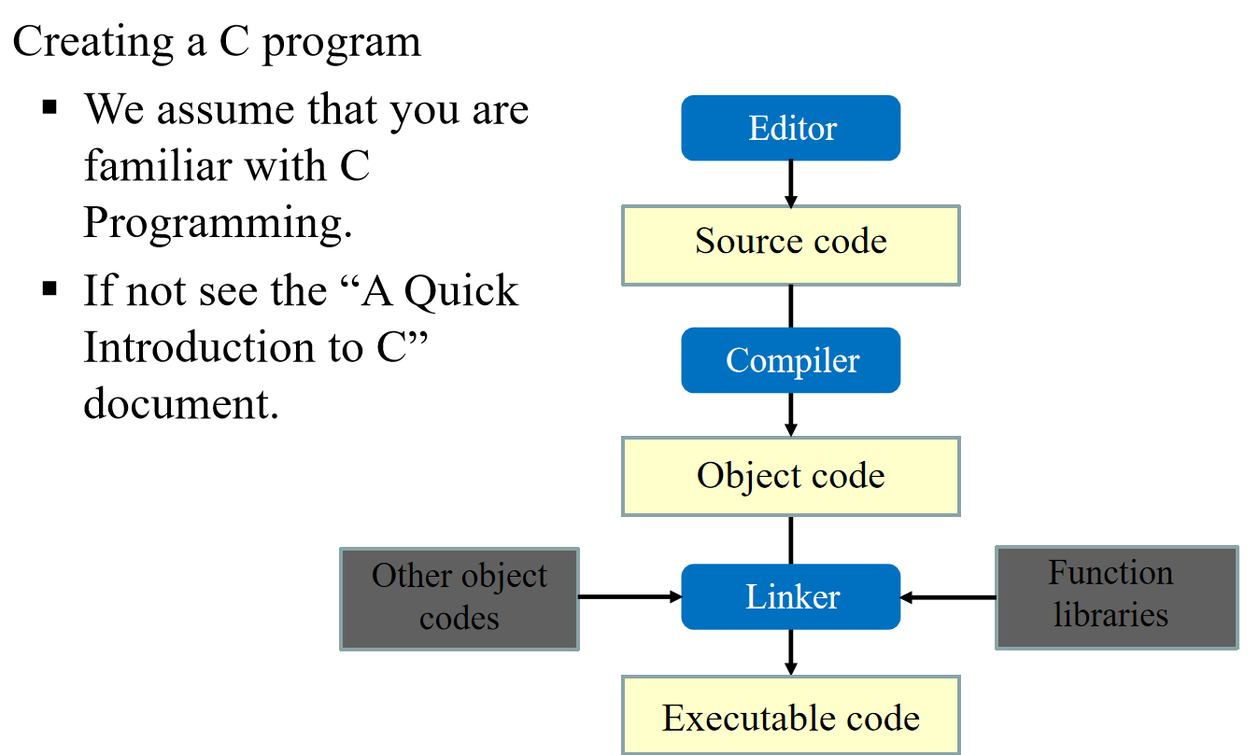
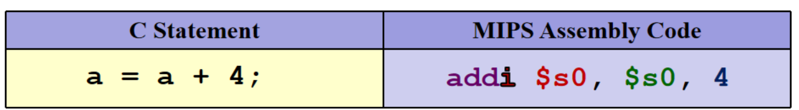
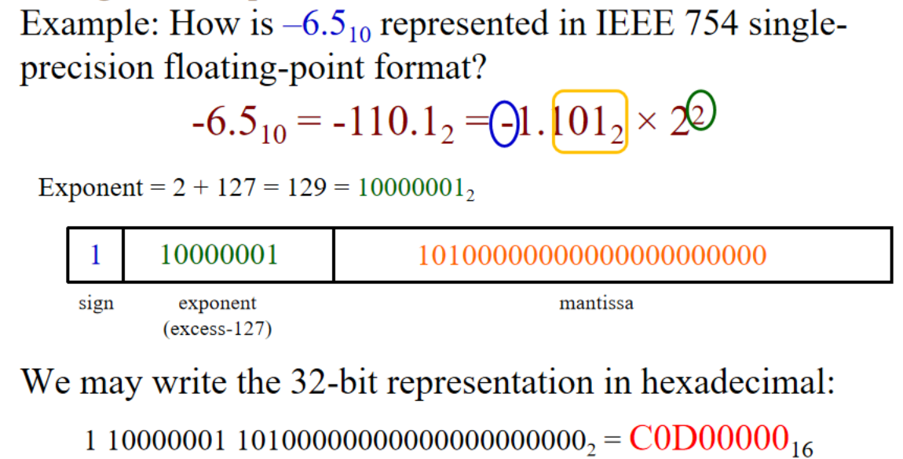
Programming Languages:
A formal language that specifies a set of instructions for a computer to implement specific algorithms to solve problems
  General Purpose Registers
  There are 32 registers in MIPS referred by a number
  ($0, $1, …, $31) or a name (eg: $a0, $t1)
$zero($0): Constant value 0
1st Generation Languages: Machine language
2nd Generation Languages: Assembly language
3rd Generation Languages: FORTRAN, COBOL, C, BASIC
4th Generation Languages: SQL, PostScript, Mathematica
5th Generation Languages: mainly in A.I. research
Functional: ( Lisp, Scheme, SML) / Logic(Prolog)
General Instruction Syntax
C Language: imperative procedural language
$s0 = $s1 - $s2
Use temporary registers $t0 to $t7 for intermediate results
Immediate values
16-bit 2s complement number [-2¹⁵ to 2¹⁵-1]
MIPS Instructions
Arithmetic instructions
指令 | 格式 | 含义 | 示例
add | R | 加法（有符号，可能溢出） | add $t0, $t1, $t2
addi | I | 加立即数（有符号，可能溢出） | addi $t0, $t1, 10
sub | R | 减法（有符号） | sub $t0, $t1, $t2
Logic instructions
and | R | 按位与 | and $t0, $t1, $t2
or | R | 按位或 | or $t0, $t1, $t2
xor | R | 按位异或 | xor $t0, $t1, $t2
nor | R | 按位或非 | nor $t0, $t1, $t2
andi | I | 与立即数 | andi $t0, $t1, 0xFF
ori | I | 或立即数 | ori $t0, $t1, 0xFF
xori | I | 异或立即数 | xori $t0, $t1, 0xFF
sll | R | 逻辑左移 | sll $t0, $t1, 2
srl | R | 逻辑右移 | srl $t0, $t1, 3
sra | R | 算术右移（符号位扩展） | sra $t0, $t1, 1
Load-store Instructions
lw | I | 从内存加载字（4字节） | lw $t0, 8($sp)
sw | I | 存储字到内存 | sw $t0, 8($sp)
lui | I | 取立即数高位 | lui $t0, 0x1001
Conditional Branch Instructions
beq | I | 相等则分支 | beq $t0, $t1, label
bne | I | 不相等则分支 | bne $t0, $t1, label
Conditional Branch Instructions
slt | R | 设置小于（有符号） (if $t1<$t2 then $t0=1 else 0) | slt $t0, $t1, $t2
slti | I | 设置小于立即数（有符号） | slti $t0, $t1, 100
Unconditional Branch Instructions
j | J | 跳转 | j label
jr | R | 跳转到寄存器指定地址 | jr $ra (用于函数返回)
jal | J | 跳转并链接（用于函数调用） | jal function_name
Unconditional Branch Instructions
syscall | 特殊 | 系统调用(根据$v0执行操作) | syscall
nop | R | 空操作 (等同于 sll $0, $0, 0) | nop
  Data Representation
  Byte: 8 bits / Nibble: 4 bits (rarely used)/ Word: Multiple of bytes
  In programming language C
  Prefix 0 for octal（八进制). Eg: 032 represents the octal number (32)₈
  Prefix 0x for hexadecimal
C Language Data type
char: 1 byte -128~127(signed) / 0~255 (unsigned)
short: 2 bytes -32,768~32,767（signed）/ 0~65,535（unsigned）
int: 4 bytes -2,147,483,648~2,147,483,647（signed）
ASCII Code
  7 bits, plus 1 parity bit (odd or even parity)
Negative Numbers
Sign-and-Magnitude: sign bit “0” for “+”, “1” for “-”
1s Complement (反码): -x = 2^{n} – x – 1
2s Complement (补码): -x = 2^{n} – x
2’s Complements on Additions
1.Perform binary addition on the two numbers.
2.Ignore the carry out of the MSB.
3.Check for overflow.
1’s Complements on Additions
1.Perform binary addition on the two numbers.
2.If there is a carry out of the MSB, add 1 to the result.
3.Check for overflow.
Excess Notation
It allows the range of values to be distributed evenly between the positive and negative values
Real Numbers
Floating Point Representation
  Instruction Set Architecture （ISA）
  An abstraction on the interface between the hardware and the low-level software.
  The major types of assembly instruction: Memory, Calculation, Control flow

Slide 2
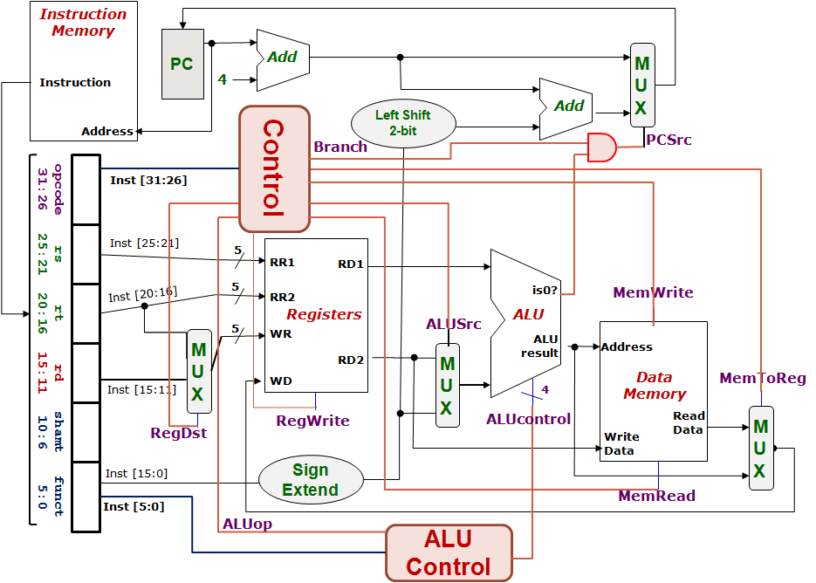
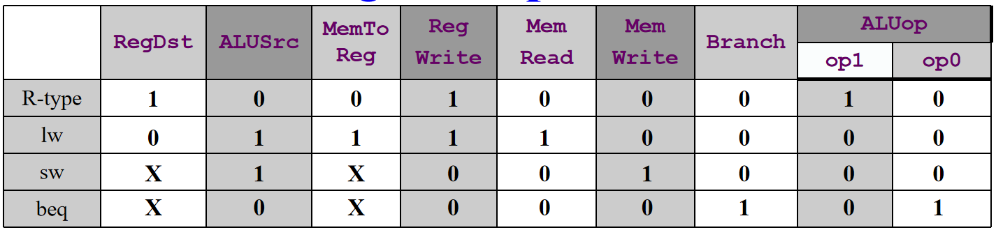
MIPS 经典冒泡排序算法：
初始化设置
addi $t0, $zero, 0 # $t0 = 0 (交换标志 swapped)
addi $t1, $zero, 0 # $t1 = 0 (外层循环计数器 i)
addi $t2, $s3, 0 # $t2 = $s3 ( ptr = 数组起始地址)
addi $t3, $s4, -1 # $t3 = $s4 - 1 ($s4 数组长度 n)
sll $t3, $t3, 2 # $t3 = ($s4 - 1) * 4 (最后一个元素的字节偏移)
add $t3, $s3, $t3 # $t3 = $s3 + ($s4 - 1)*4 (最后一个元素地址)
外层循环（标签a）
a: slt $t4, $t1, $s4 # $t4 = (i < n) ? 1 : 0
beq $t4, $zero, e # 如果 i >= n，跳转到 e (结束)
内层循环 (标签b)
b: slt $t4, $t2, $t3 # $t4 = (ptr < 最后一个元素地址) ? 1 : 0
beq $t4, $zero, d # 如果 ptr >= 最后一个元素地址，跳转到 d
lw $t4, 0($t2) # $t4 = arr[j]
lw $t5, 4($t2) # $t5 = arr[j+1]
slt $t6, $t4, $t5 # $t6 = (arr[j] < arr[j+1]) ? 1 : 0
beq $t6, $zero, c # 如果 arr[j] >= arr[j+1]，跳转到 c (不交换)
sw $t4, 4($t2) # 交换 arr[j] 和 arr[j+1]
sw $t5, 0($t2)
addi $t0, $zero, 1 # swapped = 1
内层循环迭代（标签c）
c: addi $t2, $t2, 4 # ptr += 4 (移动到下一个元素)
j b # 跳回内层循环开始
外层循环迭代（标签d）
d: beq $t0, $zero, e # 如果 swapped == 0，提前结束 (数组已排序)
addi $t0, $zero, 0 # 否则，swapped = 0
addi $t2, $s3, 0 # ptr = 数组起始地址 （重置指针，重新比较）
addi $t1, $t1, 1 # i++
j a # 跳回外层循环开始
ALUcontrol | Function
0000 | AND
0001 | OR
0010 | add
0110 | subtract
0111 | slt
1100 | NOR
MIPS Instruction Classfication
R - Format
opcode | rs |  | rt |  | rd | shamt |  | funct
6bits | 5bits |  | 5bits |  | 5bits | 5bits |  | 6bits
0 | 1st src |  | 2nd src |  | des | shift bits |  | reference
eg: add $10(rd), $7(rs), $5(rt) eg: sll $8(rd), $9(rt), 4(shamt) [For sll,srl : rs = 0]
I - Format
opcode |  | rs |  | rt |  |  | immediate
6bits |  | 5bits |  | 5bits |  |  | 16bits
eg: addi $21(rt), $22(rs), -50(immediate) eg: lw $9(rt), 12(immediate)($8(rs)) eg: beq $9(rs), $0(rt), End 分支指令的immediate 为需跳转的代码行数（注意PC），上减下加
J - Format
opcode |  | target address
6bits |  | 26bits
Identified Control Signals
Control Signal | Execution Stage | Purpose
RegDst | Decode/Operand Fetch | Select the destination register number R - Fromat Instruction : RegDst =1
RegWrite | Decode/Operand Fetch RegWrite | Enable writing of register
ALUSrc | ALU | Select the 2nd operand for ALU
ALUControl | ALU | Select the operation to be performed
MemRead / MemWrite | Memory | Enable reading/writing of data memory
MemToReg | RegWrite | Select the result to be written back to register
PCSrc | Memory/RegWrite | Select the next PC value

